Slide 1
Comprehensive Digital Marketing Project Work

Slide 2
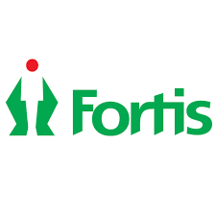
Part 1: Brand study, Competitor Analysis & Buyer’s/Audience’s Persona
Company /topic for project : FORTIS HEALTHCARE INSTITUTE
Research Brand Identity: Study the brand's mission, values, vision, and unique selling propositions (USPs).
Brand colours :
Green,RED,WHITE
Logo :
Misson/values:
Compassion, Respect for Persons, Commitment to Integrity and Ethical Practice, Commitment to Excellence, and Justice in Healthcare
USP:
IHH's Fortis is a household name in India, known for our integrated healthcare services ranging from primary to quaternary care and a wide range of ancillary services

Slide 3

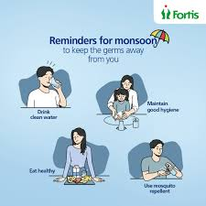
Part 1: Brand study, Competitor Analysis & Buyer’s/Audience’s Persona
COMPANY/TOPICS for project: FORTIS FOR HEALTH CARE INSTITUTE
Brand messaging: Precautions and health tips
https://www.instagram.com/p/CsITYZGtHsf/?utm_source=ig_web_copy_link
To be a globally respected healthcare organization known for Clinical Excellence and Distinctive Patient Care
Tagline:

Slide 4
Part 1: Brand study, Competitor Analysis & Buyer’s/Audience’s Persona
Competitor Analysis: Select three competitors operating in the same industry or niche as the chosen brand, examine their USPs and online communication.
Competitor 1: Global health
https://www.globalhealth.com/
Usp : global health is that it focuses on improving the health and well-being of populations worldwide, transcending geographical, social, and economic boundaries.
Online commuction : Provided offical URL and chat box
Competitor 2:manipal hospital
https://www.manipalhospitals.com/
USP : Among other specialities, the hospital's focus departments include Intensive Care, Gynaecology, Orthopaedics and General Medicine
Online communication : provided contact number and emai id
Competitor 3:max health care
https://www.maxhealthcare.in/
USP : "Max Healthcare" is a well-known healthcare provider in India, and its USP (Unique Selling Proposition) is built on several key factors that differentiate it from other healthcare providers in the region.
Online communication : provided mail id and chat box

Slide 5
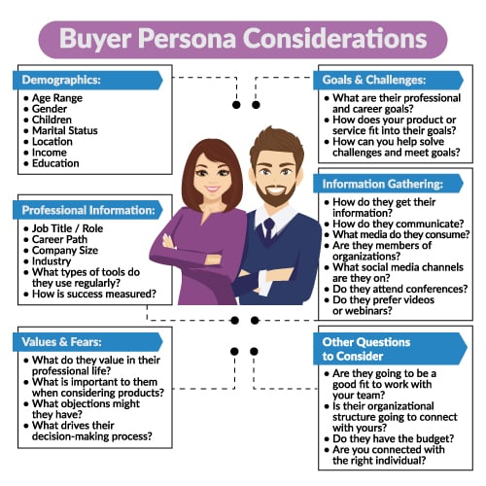
Part 1: Brand study, Competitor Analysis & Buyer’s/Audience’s Persona
Buyer's/Audience's Persona: Clearly define the target audience for the chosen brand. Consider demographics, psychographics, behaviors, and interests.
Fortis healthcare institute
Demographics :
Age:all
Gender :both
Children:eligible
Location:all over india
Income:2,50,000
Education:10+2
Information gathering:
How do they information :
Community platforms ,you tube ads,facebook ads,
Instagram ads
Values/fears:
What do they value in their professional life:
We project clinical excellence, distinctive patient care,
Transparency in actions and high level of integrity.

Slide 6
Part 2: SEO & Keyword Research
SEO Audit: Do an SEO audit of the brands website
Keyword Research: Define Research Objectives, Brainstorm Seed Keywords, Utilize Keyword Research Tools (SEMrush or Moz Keyword Explorer),Analyze Competitor Keywords, Long-tail Keyword Exploration (specific, longer phrases) that align with the research objectives and have lower competition but higher conversion potential.
On page Optimization: Meta Tag optimization & content optimization
Reflect on the process of conducting keyword research and the SEO recommendations provided.
Document the challenges faced during the research and analysis phase, as well as the key insights gained from the keyword research process.

Slide 7
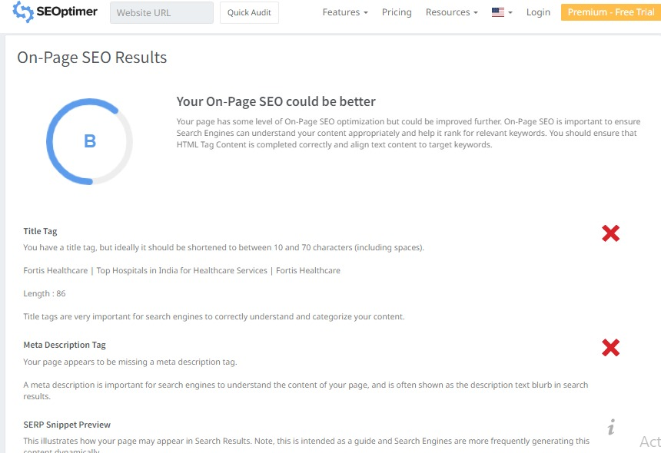

Slide 8
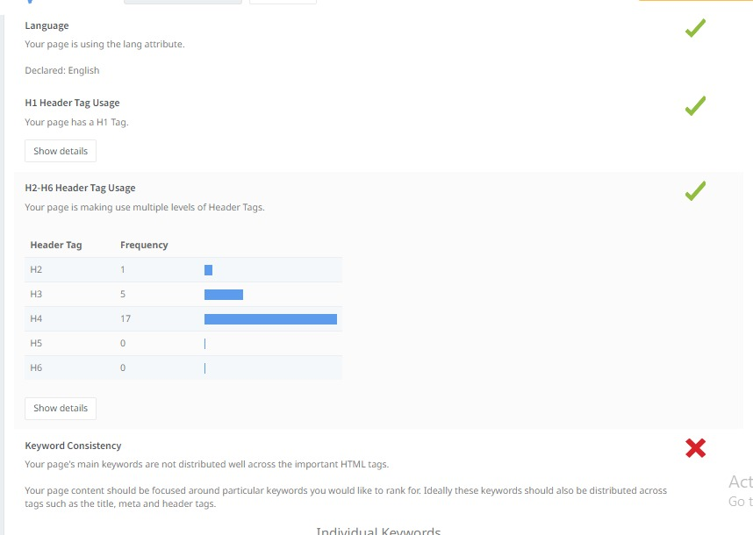

Slide 9
.
Keyword Research
Keyword: Cancer hospitals
Keyword | Avg. monthly searches | Competition
best cancer hospital in the world | 500 | Low
top 10 cancer hospitals in the world | 500 | Low
best neurosurgery hospitals in the world | 50 | Low
Meta Title
Find the best cancer and neurosurgery hospital in the world
Meta Description
Join for best treatment of cancer and neurosurgery
Keyword : Health books
Keyword | Avg. monthly searches | Competition
cosmetic surgery book | 50 | High
book online psychologist | 50 | High
gynaecologist book | 5000 | High
Meta Title
check your health book at our fortis health care institute
Meta Description
Apply for more details of your health at our health care institute

Slide 10
.
Keyword : Neurology
Keyword | Avg. monthly searches | Competition
best neurology hospitals | 500 | Low
neurology hospital near me | 5000 | Low
neurology hospital | 5000 | Low
Meta Title
Find the best neurology hospitals at our fortis health care
Meta Description
Check more hospitals for neurology treatment at our health care
Keyword : La femme
Keyword | Avg. monthly searches | Competition
fortis la femme | 5000 | Low
la femme fortis | 500 | Low
la femme gk | 500 | Low
Meta Title
we introduce new la femme at our fortis health care
Meta Description
apply for best la femme treatment at our fortis health care institute

Slide 11
.
Keyword : Kidney hospitals
Keyword | Avg. monthly searches | Competition
apollo hospital kidney specialist doctor | 500 | Low
kidney stone operation cost in fortis | 50 | Low
fortis kidney institute | 50 | Low
Meta Title
find the best kidney stone operation at our fortis health care
Meta Description
apply for more kidney traetment hospitals at our health care institute

Slide 12
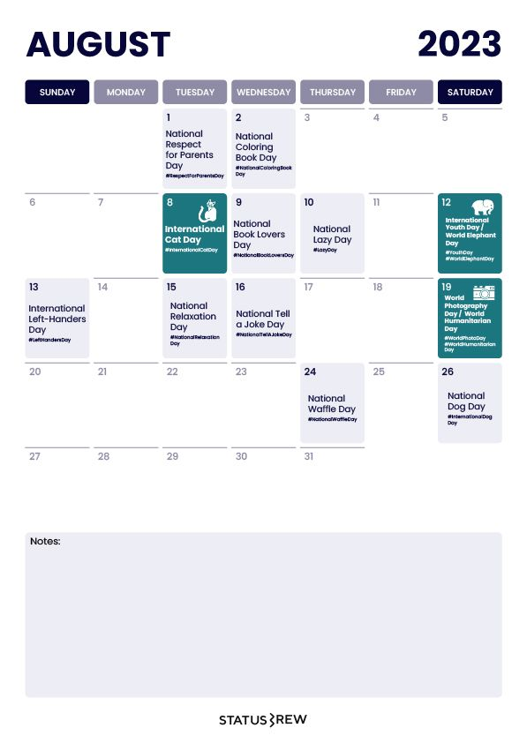
Content Idea Generation & Strategy: Create a content calendar for the remaining month of July by brainstorming content themes, exploring various formats like blog posts, videos, infographics, podcasts, and interactive quizzes, and scheduling publication dates mainly on Facebook & Instagram. And include the strategy, aim and the idea behind these posts and story Content Calendar Example (Try creating a table for the month of July)
Part 3: Content Ideas and Marketing Strategies

Slide 13
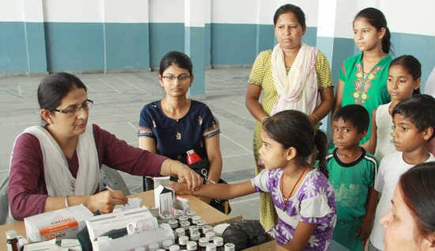
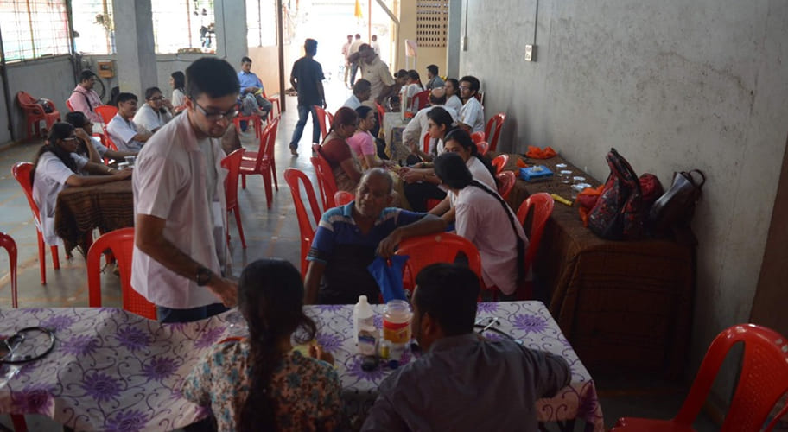

Part 3: Content Ideas and Marketing Strategies
DATE : 5TH August
To launch a free medical programme for poor people to ensure that every individual, regardless of their financial situation, can access medical care and preventive healthcare service
DATE: 6th August
To create a compelling narrative that motivates viewers to take action donations, volunteer work, or spreading awareness, in order to support the free medical program for poor people and improve their access to healthcare.
DATE: 7th August
To create a poster on awareness of health.Don’t take any medicines without any docotor prescription, its harmful to your health

Slide 14
Part 3: Content Ideas and Marketing Strategies
Reflect on the content ideas and marketing strategies process, discussing the challenges encountered and lessons learned.
Creating content ideas and devising effective marketing strategies is a dynamic process that involves continuous learning and adaptation. Throughout this journey, several challenges and valuable lessonscan be encountered.
1.Understanding the Audience: One of the primary challenges is comprehending the target audience's preferences, needs, and pain points.
2. Generating Unique Ideas: Coming up with fresh and innovative content ideas can be difficult, especially in saturated markets.
3. Consistency and Quality: Maintaining a consistent flow of high-quality content can be demanding. Settingup an editorial calendar and adhering to a content creation schedule helps in maintaining quality and meetingdeadlines.
4. Content Promotion: Even the best content may not gain traction without proper promotion, Crafting effective marketing strategies to reach the target audience across various channels is crucial for success.
5. Collaboration: Collaborating with influencers or other brands can amplify the reach of content andstrengthen marketing efforts.
The content ideas and marketing strategies process is an iterative and learning-oriented journey

Slide 15
Part 4: Content Creation and Curation (Post creations, Designs/Video Editing, Ad Campaigns over Social Media and Email Ideation and Creation)
Post Creation:
Select Content Categories: Identify three different content formats relevant to the chosen topic or industry. Research and Brainstorm: Research trending topics, industry news, or audience interests within each category. Brainstorm ideas for social media posts that align with each category. Do note that 1 content format has to be video and additionally 3 stories/status are to be created.
Format 1 : Blog article
Format 2 : Video
Format 3 : Creative

Slide 16
Part 4: Content Creation and Curation (Post creations, Designs/Video Editing, Ad Campaigns over Social Media and Email Ideation and Creation)
Format 1:Blog Article
AIM: TO launch a free medical programme for poor people
DATE:29th july 2023
Idea:to ensure that every individual, regardless of their financial situation, can access medical care and preventive healthcare services.
Title: Ensuring Access to Medical Care and Preventive Health Services for All: A Step-by-Step Guide
Introduction:Access to medical care and preventive health services is a fundamental human right that should be available to every individual, regardless of their financial situation. Unfortunately, financial constraints often create barriers to essential healthcare, leading to unequal health
Step 1: Identify Existing BarriersThe first step in addressing the issue of healthcare access is to identify the existing barriers. Conduct thorough research, surveys, and engage with healthcare providers and communities to understand the challenges faced by individuals with limited financial means

Slide 17
Step 2: Develop Financial Assistance ProgramsCreate or expand financial assistance programs to support individuals who cannot afford medical care. These programs can be funded by government initiatives, private organizations, or a combination of both. Ensure that the application process is simple and accessible to those in need .Step 3: Establish Community Health CentersCommunity health centers play a vital role in providing healthcare services to underserved populations. Establish and fund these centers in areas with limited access to medical facilities. These centers should offer a range of preventive health services, including vaccinations, screenings, and health education programs .Step 4: Strengthen Telemedicine ServicesTelemedicine has the potential to bridge the gap between healthcare providers and patients in remote or financially disadvantaged areas. Invest in telemedicine infrastructure and promote its use, especially for preventive health consultations and follow-ups. Step 5: Public Awareness CampaignsConduct public awareness campaigns to educate communities about the importance of preventive health measures. Emphasize the benefits of early detection, regular check-ups, and healthy lifestyle choices. Use various media channels to reach a broader audience. Step 6: Collaborate with Nonprofit OrganizationsForge partnerships with nonprofit organizations that focus on healthcare access. Pool resources and expertise to reach a larger number of individuals in need. These organizations can also help in identifying target populations and delivering services effectively.

Slide 18
.
Step 7: Advocate for Policy ChangesAdvocate for policy changes at local, regional, and national levels to prioritize healthcare access for all citizens. Lobby for increased funding for healthcare programs, expansion of Medicaid, and other policies that promote universal healthcare coverage.
Step 8: Address Language and Cultural BarriersRecognize that language and cultural barriers can hinder access to healthcare services. Hire multilingual staff and provide cultural competency training to healthcare professionals to ensure that patients feel comfortable and understood.
Step 9: Foster Preventive Health Initiatives in SchoolsPromote preventive health education in schools to instill healthy habits from an early age. Collaborate with educational institutions to include health and wellness programs in their curriculum
.Step 10: Monitor Progress and Evaluate ImpactRegularly monitor the implementation of these initiatives and assess their impact on healthcare access and preventive health outcomes. Gather feedback from communities and make necessary adjustments to improve effectiveness.

Slide 19
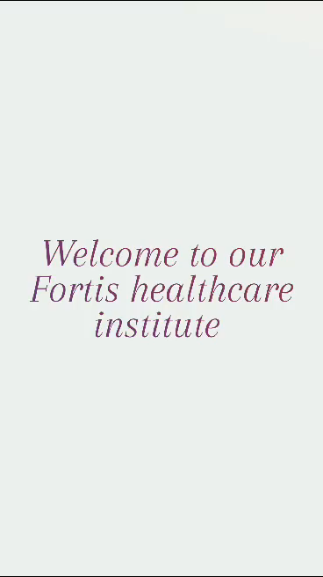
Part 4: Content Creation and Curation (Post creations, Designs/Video Editing, Ad Campaigns over Social Media and Email Ideation and Creation)
.
Format 2:VIDEO
Aim: To create a compelling narrative that motivates viewers to take action
DATE:1St AUGUST
Idea: donations, volunteer work, or spreading awareness, in order to support the free medical program for poor people and improve their access to healthcare.

Slide 20
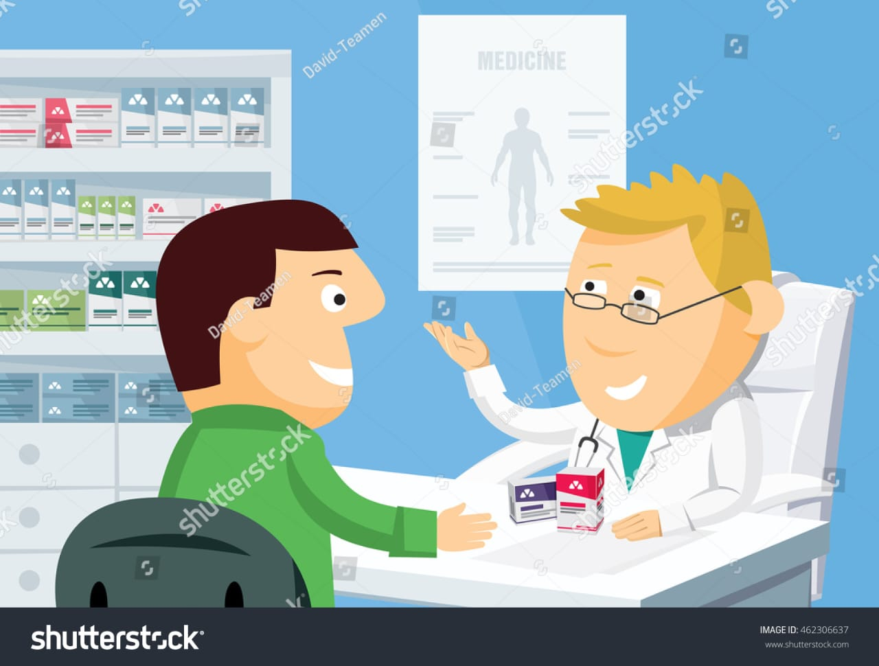
Part 4: Content Creation and Curation (Post creations, Designs/Video Editing, Ad Campaigns over Social Media and Email Ideation and Creation)
FORMAT 3:CREATIVE
AIM:To create a poster on awareness of health
DATE:4TH AUGUST 2023
IDEA:Don’t take any medicines without any docotor prescription, its harmful to your health
TOPIC:POSTER

Slide 21
Part 4: Content Creation and Curation (Post creations, Designs/Video Editing, Ad Campaigns over Social Media and Email Ideation and Creation)
Instagram Story
Utilize the Stories feature on Instagram for three consecutive days. Share behind-the-scenes glimpses, polls, quizzes, or sneak peeks etc to encourage audience participation. Once uploaded use the story highlight feature on Instagram and save the 3 story with an appropriate name for each.
Note:
Once done monitor the performance of the posts and Stories using the insight tool and analyze the engagement metrics (likes, comments, shares, impressions, etc.). Based on the analysis, mention the strategies and areas for improvement.

Slide 22
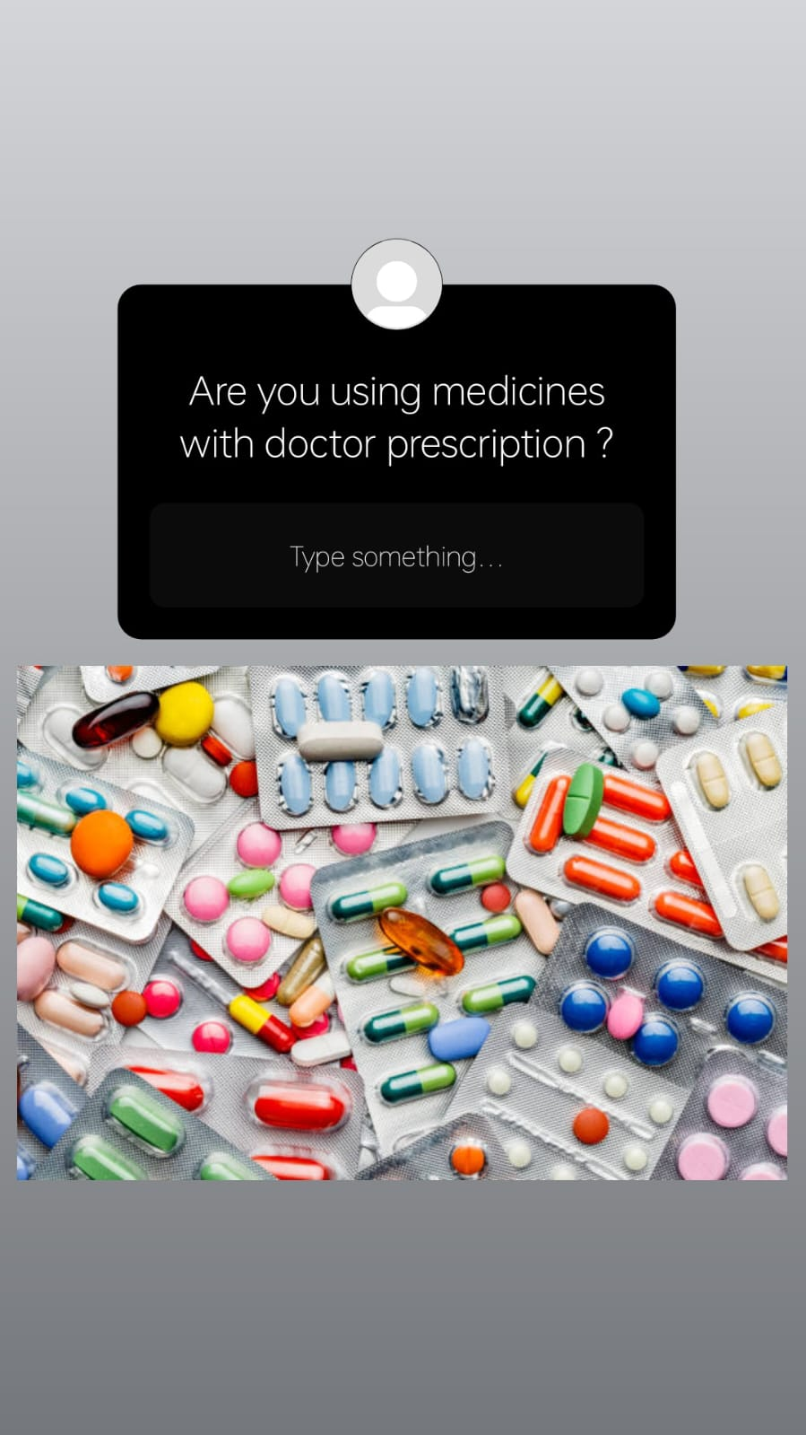

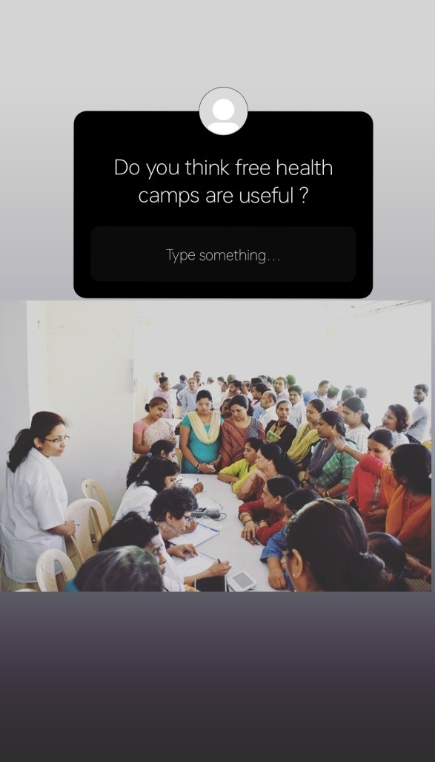
Part 4: Content Creation and Curation (Post creations, Designs/Video Editing, Ad Campaigns over Social Media and Email Ideation and Creation)
Instagram Story

Slide 23
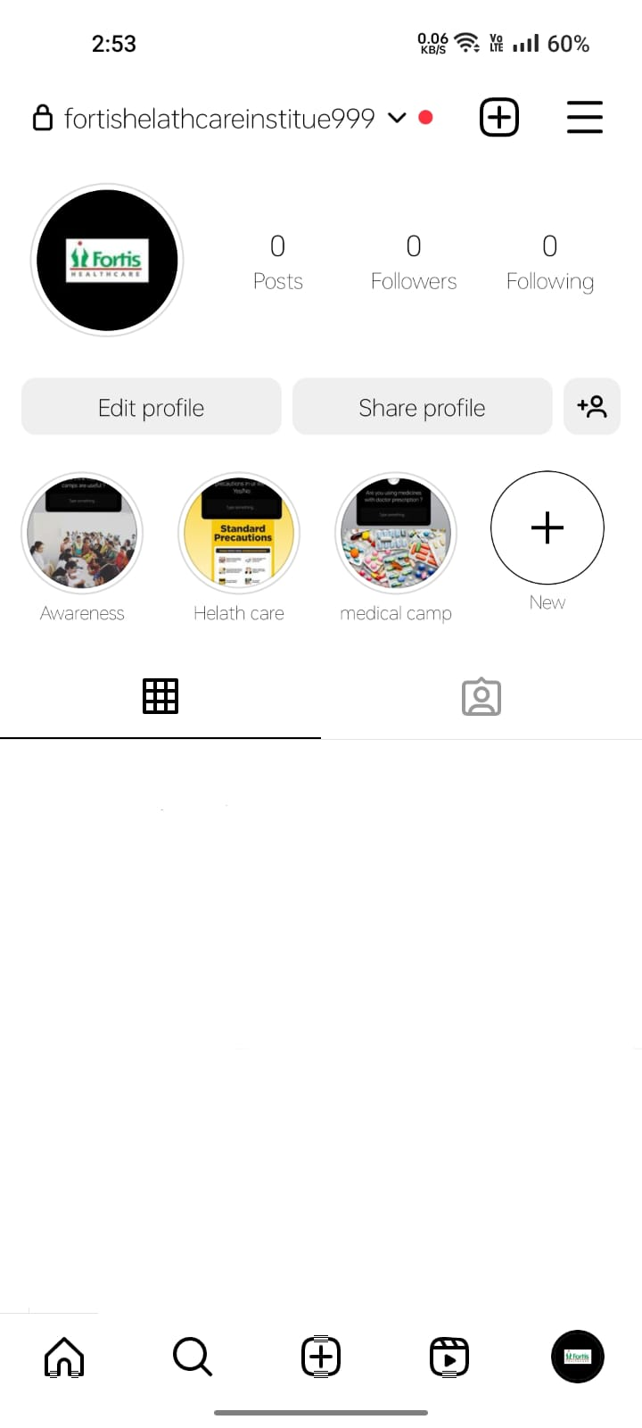
.

Slide 24

Part 4: Content Creation and Curation (Post creations, Designs/Video Editing, Ad Campaigns over Social Media and Email Ideation and Creation)
Designs/Video Editing
Design Tools Familiarization (use Canva for creating visually appealing graphics)
Video Creation: Utilize VN or any video editor of your choice to create videos related to the chosen topic.

Slide 25
Part 4: Content Creation and Curation (Post creations, Designs/Video Editing, Ad Campaigns over Social Media and Email Ideation and Creation)
Social Media Ad Campaigns
Ad Campaigns over Social Media:
Come up with 3 ad campaigns each covering one of the mentioned goals: brand awareness, driving website traffic, or generating leads

Slide 26
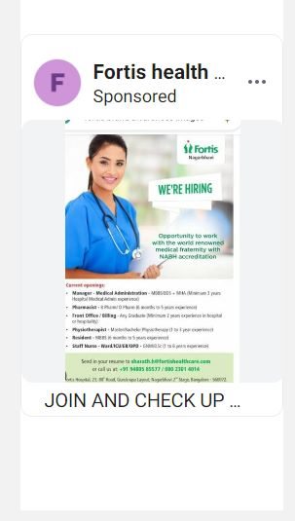
Brand awareness : This video has been uploaded in instagram

Slide 27
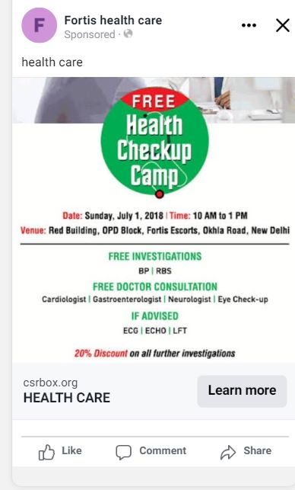
Driving traffic website

Slide 28
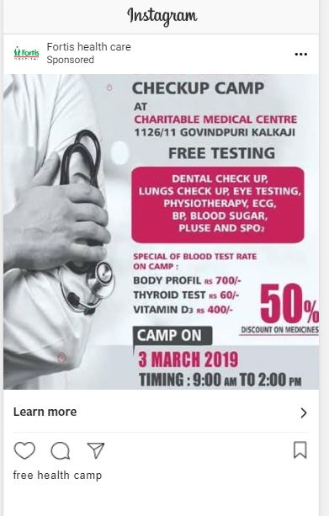
Generating lead :

Slide 29
Part 4: Content Creation and Curation (Post creations, Designs/Video Editing, Ad Campaigns over Social Media and Email Ideation and Creation)
For every campaign clearly define:
Advertising Goals: increasing brand awareness, driving website traffic, or generating leads.
Audience Targeting: Define the target audience for the ad campaigns based on demographics, interests, and behavior.
Ad Creation: Create visually appealing ad creatives, compelling ad copy and relevant call-to-action.

Slide 30
Part 4: Content Creation and Curation (Post creations, Designs/Video Editing, Ad Campaigns over Social Media and Email Ideation and Creation)
Email Ad Campaigns
Ad Campaigns for email marketing:
Come up with 2 email ad campaigns with the mentioned goals: brand awareness & generating leads

Slide 31
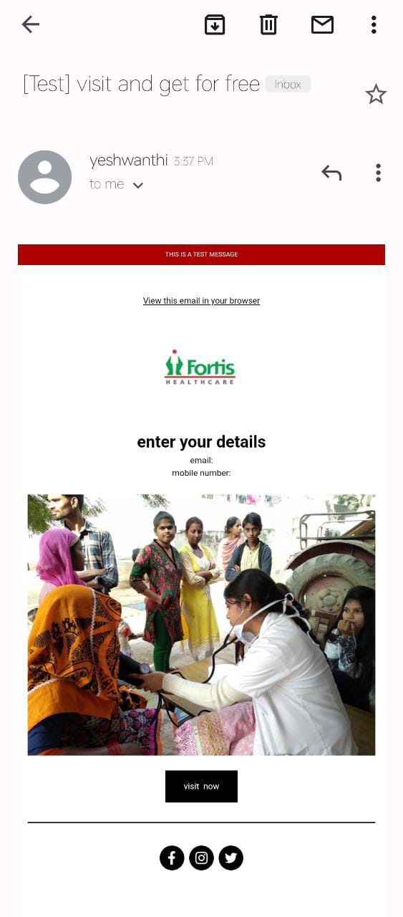
Email Ad Campaign 1 - Brand Awareness
(insert emailer image)

Slide 32
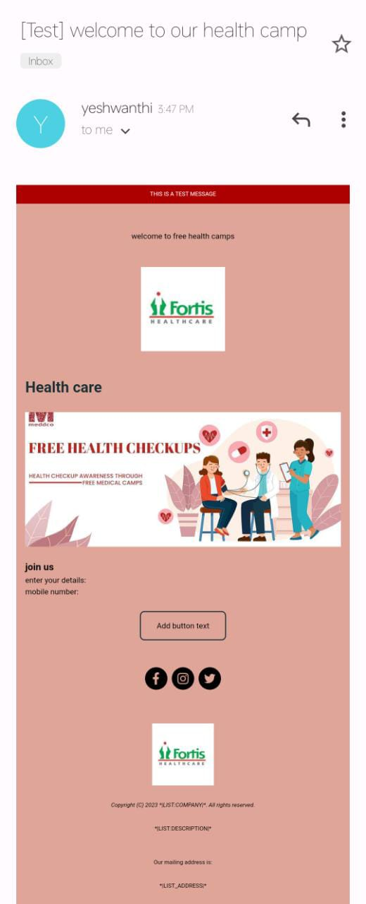
Email Ad Campaign 2 - Lead Generation
(insert emailer image)

Slide 33
Part 4: Content Creation and Curation (Post creations, Designs/Video Editing, Ad Campaigns over Social Media and Email Ideation and Creation)
Reflect on the content creation and curation process, discussing the challenges faced and lessons learned.
1.Know our Audience: Understanding the target audience's interests, pain points, and preferences is fundamental increating relevant and engaging content.
2.Visual Appeal: Fye-catching visuals, well-designed graphics, and professionally edited videos can significantly enhance the impact of content and ad campaigns.
3. Consistency is Key: Maintaining a consistent tone, style, and frequency of content across platforms helps reinforce brand identity and improves audience recall.
4. A/B Testing: Regularly conducting A/B tests for ad campaigns and email subject lines allows for data-drivenoptimization and better results.
5. Engage with the Audience: Responding to comments, messages, and feedback from the audience fosters a senseof community and builds trust.
6. Long-Term Approach: Content creation and marketing are not one time endeavors. A long-term, strategic approach is necessary to build brand awareness and achieve sustainable growth.
In conclusion, content creation and curation, along with thoughtful design, video editing, and well executed ad campaigns, play a pivotal role in a successful marketing strategy. By understanding the challenges and incorporating the lessons learned, businesses can create compelling content that resonates with their target audience and drives results:

